Slide 1
Project 1
Presentation – Jack Glutting-Gilsdorf

Slide 2
Introduction:
This project involves programming the MSP-430 implement a "heartbeat" LED as a debugging indicator, flashing at 0.5 Hz. The task requires two approaches: a delay loop with subroutines for the P1.0 LED and a timer module with interrupts for the P6.6 LED, ensuring both LEDs flash at the specified frequency. The final step involves fine-tuning the code to achieve an exact 0.5 Hz signal, verified with an oscilloscope.

Slide 3
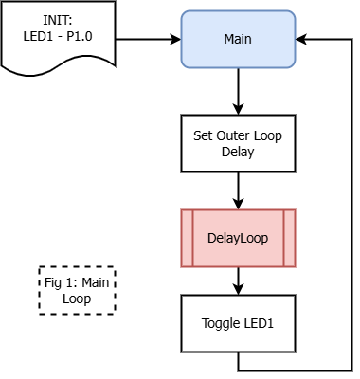
Main Loop:
Used:
Red LED1 P1.0
Delay loop iteration storage variables
Subroutines:
DelayLoop
Purpose:
Flash P1.0 LED every iteration using the subroutine Delayloop. Resets outer loop delay variable each time through.

Slide 4
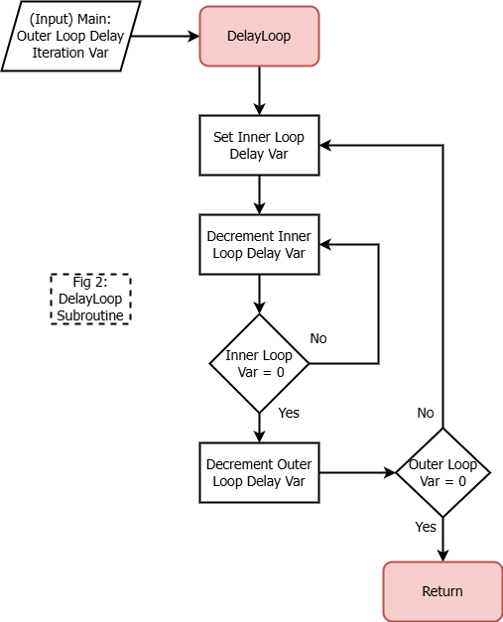
DelayLoop(Polling):
Used:
Value from main for Outer Loop Delay
Summary:
Iterative loop setup with two nested loops
The inner loop runs 332 iterations, with each iteration taking 3 cycles, plus an additional 2 cycles for setup and 2 nop instructions for exact timing.
Outer Loop is set by main loop and was originally 1000 representing milliseconds.

Slide 5
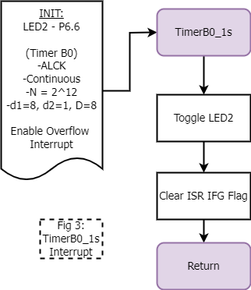
Interrupt:
Summary:
Routine toggles the P6.1 output each time the Timer B0 CCR0 interrupt occurs, creating a 1-second interval for the LED toggle. It also clears the CCR0 interrupt flag to ensure the ISR does not repeatedly trigger unnecessarily.
The Timer B0 module is configured with ACLK as the clock source and a divider of 8, resulting in a clock frequency of 32768 Hz / 8 = 4096 Hz. The CCR0 register is set to 4096, so the timer generates an interrupt every 4096 clock cycles, equivalent to 1 second.
;----- Setup Timer B0 -----
#TBCLR, &TB0CTL ; Clear timer and dividers
#TBSSEL__ACLK, &TB0CTL ; Select ACLK as timer source
#MC__UP, &TB0CTL ; Choose UP mode for periodic interrupts
#ID__8, &TB0CTL ; Divider = 8
#4096, &TB0CCR0 ; Set CCR0 for 1-second match
#TBIFG, &TB0CCTL0 ; Clear CCR0 interrupt flag
#CCIE, &TB0CCTL0 ; Enable CCR0 interrupt

Slide 6
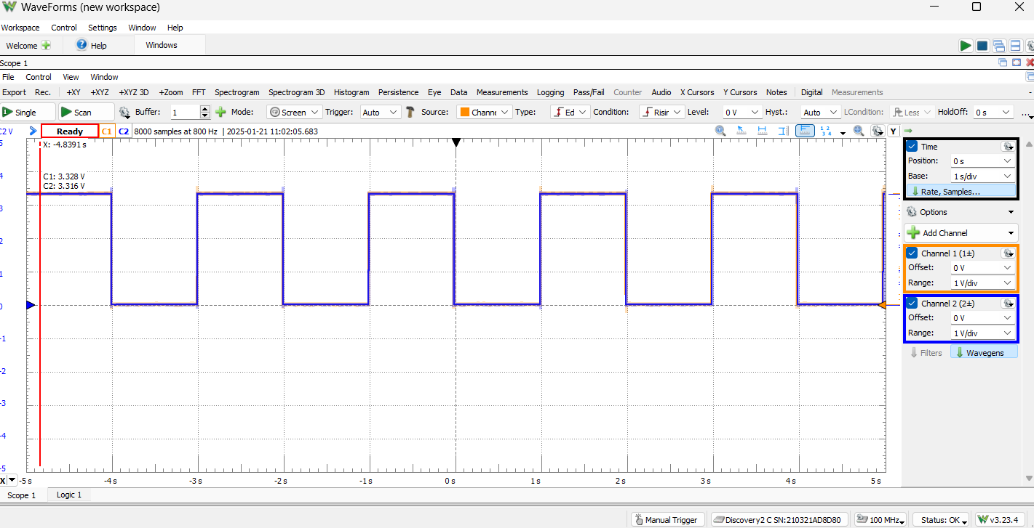
Final Timing Diagram
Changed the value of Outer loop iteration counter for Delayloop subroutine from 1000 to 1045

